Slide 1
Wellness and Your choices
Chapter 1

Slide 2
Health vs. Wellness
Health – freedom from physical disease, poor physical conditions, social maladjustments, and other negative states.
What are the different types of health?
Physical, Mental, Social, Spiritual, and Emotional.
Wellness – maximum well-being, the top of the range of health states.

Slide 3
What are daily choices that affect your health?
LIFESTYLE CHOICES

Slide 4
The Leading Causes of DEATH.
1890’s
Today
Flu
Pneumonia
Tuberculosis
Digestive System
Bronchitis
Scarlet Fever
Stroke
Kidney Failure
Heart Disease
Cancer
Respiratory Disease
Accidents
Stroke
Alzheimer's
Diabetes
Flu
Suicide

Slide 5
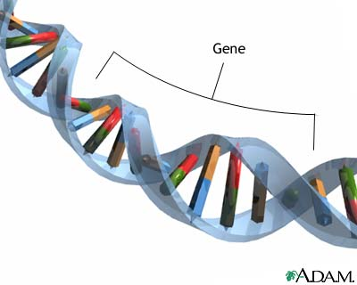
Family Medical History and Environment
Heredity – family members may carry a gene that makes it more likely to get a disease.
Environment – infectious disease, pollution in the air, water and food.
Physical environment
Social environment
Cultural environment

Slide 6
Family Tree Assignment
Due Friday January 29

Slide 7
AGE: a matter of definition.
Chronological age – age as measured in the years from date to birth.
Physiological age – age as estimated from the body’s health and probable life expectancy?
FIVE FACTORS that have the most impact:
Get 8 to 9 hours of sleep
Eat regular, nutritious meals, including breakfast.
Engage in regular physical activity.
Avoid the use of tobacco, alcohol, and other drugs.
Maintain a healthy weight.

Slide 8
What do you call someone who is 100 years or older?
Centenarians.

Slide 9
Each Row will have one category of health.
Physical. Social. Mental/Emotional. Spiritual.
You have 5 minutes to develop a list of qualities for their aspect of health.

Slide 10
Making Behavior changes
Chapter 1; Section 3

Slide 11
What MOTIVATES You?
Internal Motivation vs. External Motivation – what is the difference?
Motivation Goal setting Accomplishing goals Changed Behavior
Go to page 19 to see how to set specific goals.

Slide 12
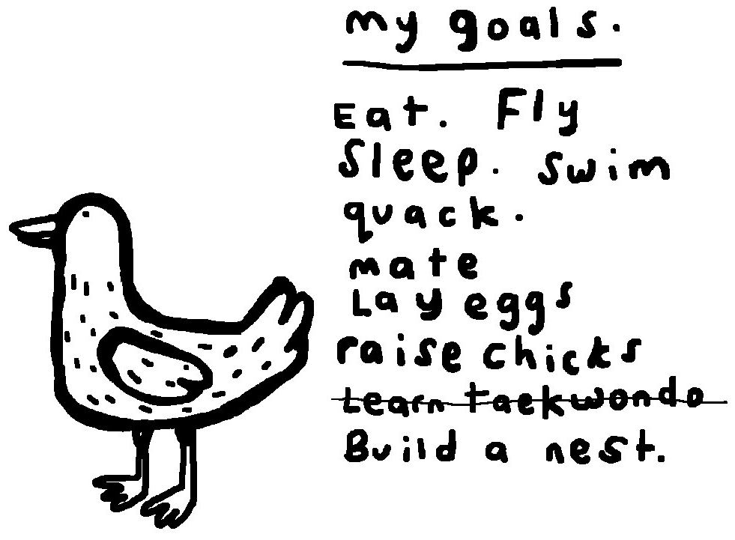
Types of GOALS.
Short Term goal- something you want to accomplish soon.
Today, this week, this month.
Long Term goal – something you want to accomplish
in the future.
This month, this year, a few years from now.

Slide 14
What are YOUR GOALS?
What do you want to accomplish by this month?
What do you want to accomplish by the end of high school?
What do you want to accomplish after high school? (college, work, etc.)
What do you want to accomplish 20 years from now?
Looking back at your life (70yrs. old), what would be your message to yourself? Did you accomplish all your goals?

Slide 15
Emotional Health
Chapter 2

Slide 16
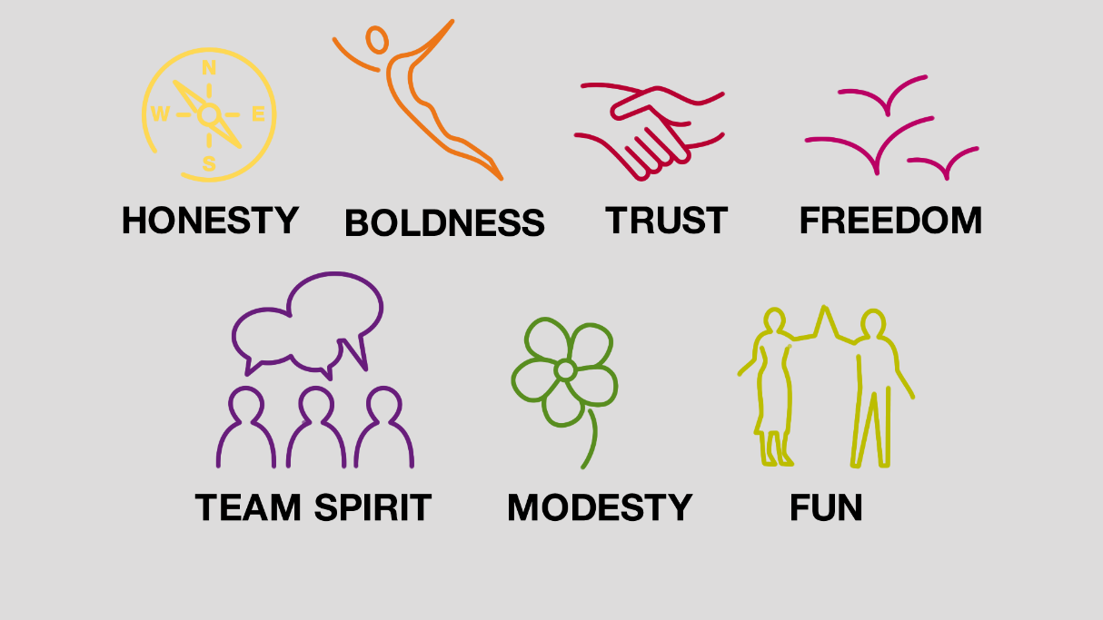
Values. Learning to manage and live by your values is an important part of emotional health.
Values – what a person thinks of as right and wrong or see as important.
What do you value?
In your notebook list your personal values.

Slide 17
Emotions. Recognizing, accepting, and expressing feelings are important to emotional health.
Expressing emotions. “laughing” “crying” “speaking” “writing” “shouting”
Resentment – anger that has built up due to failure to express.
Suppress – hold back or restrain.
Confrontation – interaction in which one person expresses feeling to another.

Slide 18
Relating to Others. Definitions.
Who is your support system?
Do you have a mentor?

Slide 19
Resolving Conflicts. How do you feel about each statement?
A person who gives in when conflict arises is cooperative.
A person who walks away is afraid.
A person who does nothing saves the other person’s feelings.
A person who fights dirty usually wins.
A person who tries to understand the other’s point of view can meet his or her own needs doing so.

Slide 20
Five conflict resolution strategies.
Page 37. Complete chart individually or with a partner.

Slide 21
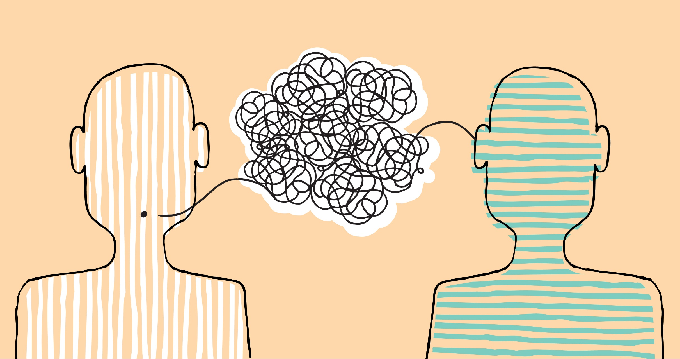
Communication. Two way exchange of ideas or thoughts.
Assertive – possess the characteristics of appropriately expressing feelings, wants and needs while respecting those of others.
Passive – not expressing feelings appropriately.
Aggressive – to be overly demanding of others.
Examples on page 38

Slide 22
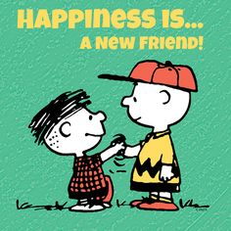
New Relationships.
S mile
O pen Posture
F orward Lean
T ouch
E ye contact
N od

Slide 23
Making Decisions. Problems can be solved by making decisions and taking action.
What impacts the decisions you make in your life?
The Decision-Making Process
Name the problem.
Describe the problems parts.
Brainstorm.
Think about each solution.
Choose a solution and act.
Evaluate the Outcome.

Slide 24
Choose a Problem from the next slide.
Use the Decision-Making steps to solve the problem.

Slide 25
It’s my senior year and I just found out I am pregnant. I also just accepted a soccer scholarship to school. My parents do not know yet either. AHHHHHHHHHHHH.
I wrecked my Dad’s car. I lied to where I was going. It was also my fault.
I got pulled over for going through a stop sign. The worst part is my friend had marijuana on him. We are headed to the station. YIKES!
I have a huge project due tomorrow. I only finished half. However, my friend has hers from last semester. Should I use it?

