Slide 1
Lifestyle Diseases
Chapter 17
Pg. 450

Slide 2
Lifestyle disease
Or non-communicable diseases, cannot spread from person to person. Brought on partly by the choices we make each day.

Slide 3
Types of Lifestyle Diseases
Diabetes
Heart Attack
Stroke
Cardiovascular Disease
Cancer
AIDS

Slide 4
Leading Cause of Death in the U.S.
Heart disease: 597,689
Cancer: 574,743
Chronic lower respiratory diseases: 138,080
Stroke (cerebrovascular diseases): 129,476
Accidents (unintentional injuries): 120,859
Alzheimer's disease: 83,494
Diabetes: 69,071
Nephritis (inflammation of kidneys): 50,476
Influenza and Pneumonia: 50,097
Intentional self-harm (suicide): 38,364

Slide 5
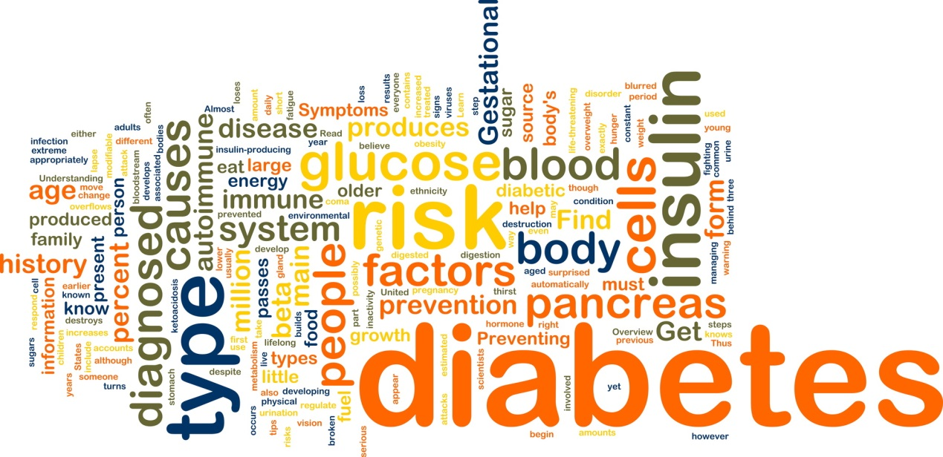
Diabetes
Condition of abnormal use of glucose, usually caused by too little insulin or lack of response to insulin.
  Glucose – Blood’s sugar
  Insulin – hormone produced by the pancreas and released in response to high blood glucose following a meal.
  http://www.youtube.com/watch?v=jHRfDTqPzj4

Slide 6
Diabetes
Diabetes is the leading cause of blindness and kidney failure in the U.S.
It can also lead to heart disease and stroke as well
More than 20 million people in the U.S. have diabetes.

Slide 7
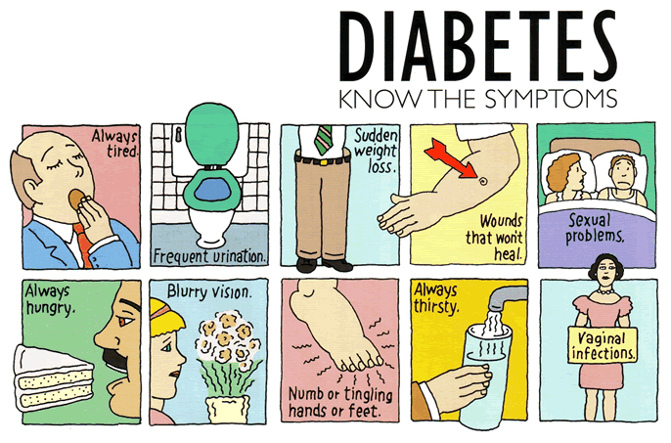

Slide 8
Types of Diabetes
Type 1
Type 2
Own immune system attacks pancreas and doesn’t produce insulin.
  Less than 10% of diabetic population.
  Insulin dependent ALWAYS
Does not produce enough insulin due to excess fat.
  90% of diabetic population.
  Insulin dependent SOMETIMES

Slide 9
Cardiovascular Disease (CVD)
A general term for all diseases of the heart and blood vessels.
**#1 killer of American adults**
*In the U.S., about 1 in 3 people have some form of the disease and it claims the lives of nearly 1 million people each year.

Slide 10
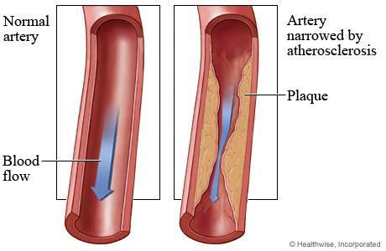
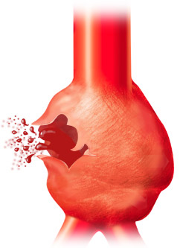
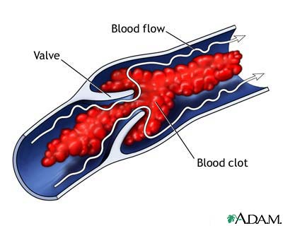
Atherosclerosis - disease characterized by plaques along the inner walls of the arteries. Obstructs blood flow and makes blood clots likely. Most common form of CVD.
Plaque- build up of fat, damage the artery walls & narrow passageways
Aneurysm-ballooning out of an artery wall where it has grown weak
  Hemorrhage – significant bleeding.
Embolism – traveling blood clot.

Slide 11
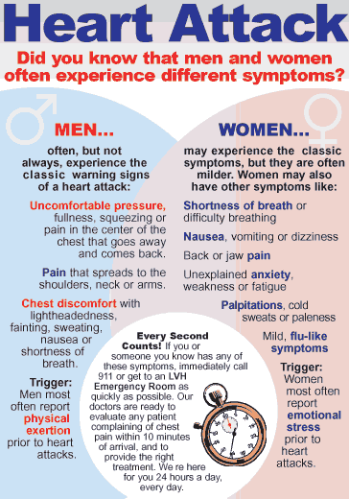
Heart Attack - vessels that feed the heart muscle become blocked, causing tissue death. When heart tissue dies, it is replaced by scar tissue that cannot pump efficiently.

Slide 12
Medical Treatments for Heart Disease
Pacemaker – device that delivers electrical impulses to the heart to regulate heartbeat. Can be implanted.
Bypass Surgery – provides alternate route for blood to reach heart, bypassing a blocked artery.
Heart Transplant – surgical replacement of a diseased heart with a healthy one. Rejection of new heart is always a threat.
Artificial Heart – pump designed to fit into the human chest cavity and perform the heart’s functions of pumping blood around the body. (used for year or longer)
Human Gene Therapy – use of genetic material to treat, cure, or prevent diseases such as heart disease and cancer. If research succeeds, physicians may one day treat diseases by replacing defective disease-causing genes with healthy genetic material in a person’s cells.

Slide 13
Stroke
Blockages or hemorrhages in the vessels that feed the brain.
Third leading cause of death in the U.S.
Sometimes before a major stroke occurs, a person will experience mini strokes or small strokes. These warn a blockage is forming.
A minor stroke may have no lasting effect. Survivors of severe stroke may lose the ability to walk, talk, form words, or move their arms and/or legs. Sometimes this damage is permanent.

Slide 14
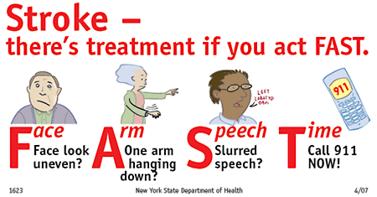
Stroke - the shutting off of the blood flow to the brain by plaques, a clot, or hemorrhage.

Slide 15
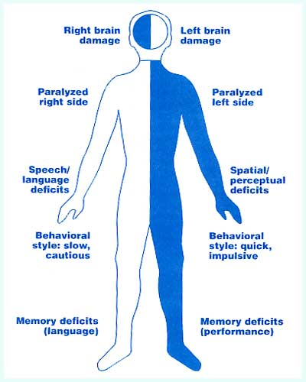
The Effect of Stroke Location
Damage on one side of the brain affects the opposite side of the body.

Slide 16
Reducing the Risks of CVD
Some of the major risk factors for heart disease are age, heredity, gender (male), smoking, smokeless tobacco, obesity, hypertension (high bp- 120/80 is avg.), high blood cholesterol, high fat diet, physical inactivity, and diabetes.
The more risk factors = the greater the risk of disease
Cholesterol-a type of fat
  LDL- bad cholesterol
  HDL- good cholesterol

Slide 17
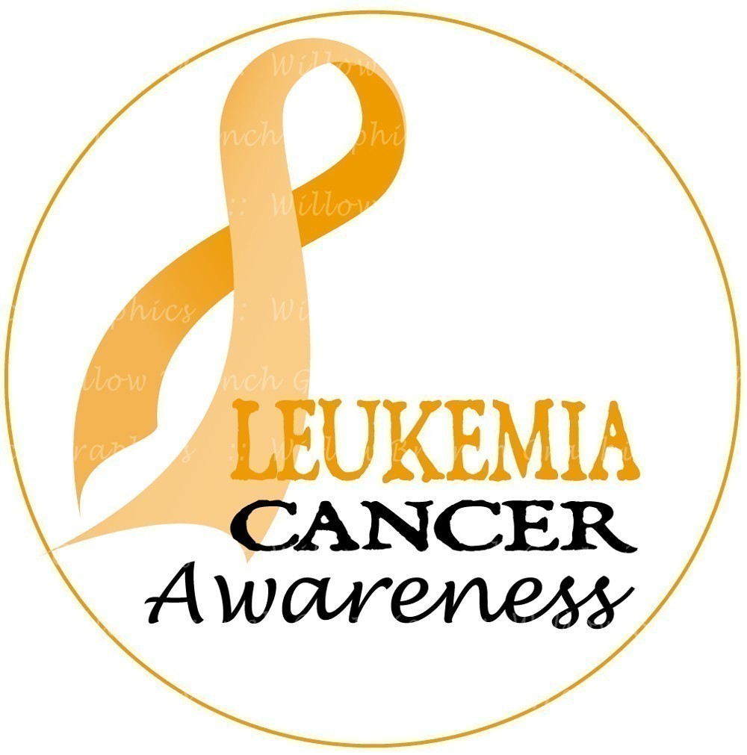

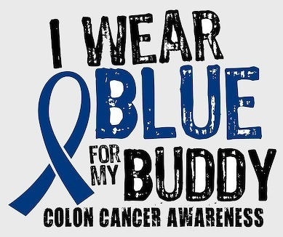




Slide 18
Cancer – disease in which abnormal cells multiply out of control, spread into surrounding tissues and other body parts, and disrupt normal functioning of one or more organs.
There are over hundred diseases called cancer. Each has its own name and symptoms, depending on its type and location in the body.
  Cancers that arise in organs of the immune system are Lymphomas.
  Cancers that arise in the blood cell-making tissues of blood forming organs are Leukemia's.
  Cancers that arise in the skin, body chamber linings, or glands are Carcinomas.
  Cancers that arise in the connective tissue cells, including bones, ligaments, and muscles, are Sarcomas.
  Cancers of glandular tissues such as the breast are Adenomas.

Slide 19
“ Oma” ?
“oma” means tumor, an abnormal mass of tissue that can live and reproduce itself, but performs no service to the body.
  Benign – noncancerous, not harmful
  Malignant – Cancerous tumors
    Metastasized – when the cancer cells have migrated from one part of the body to another, and started new growths just like the original tumor.

Slide 20
How does Cancer develop?
Damage to a cell’s DNA causes abnormal cell division. (cells multiply when the body doesn’t need them too)
  Environment
  Habits – smoking, drinking, chewing tobacco, etc.
  Gender, medical history, and age
Mass growth, tumor, occurs (can take months or years to develop)
  As tumor gains size, it competes with normal tissues for nutrients, oxygen, and space. With time it can interrupt the normal functions of the tissue/organ.
    Tumor of the brain effects control of body functions.
    Tumor of the colon effects passage of intestinal contents.

Slide 21

Skin Cancer http://www.skincancer.org/
What You Need to Know:
  Skin cancer is the most common form of cancer in the United States. More than 3.5 million skin cancers in over two million people are diagnosed annually.
  Each year there are more new cases of skin cancer than the combined incidence of cancers of the breast, prostate, lung and colon.
  One in five Americans will develop skin cancer in the course of a lifetime.

Slide 22
Skin Cancer - Pg. 477 - 479

Slide 23
Disease | Early Symptoms | Survival (with early diagnosis and prompt treatments)
Brain/Nervous System Cancer | Personality changes; bizarre behavior; headaches; vision changes, nausea, vomiting, seizures. | Poor
Breast Cancer | Unusual lump, thickening in, dimple in or discharge from nipple. | Excellent (up to 90%)
Hodgkin’s Lymphoma | Swelling of lymph nodes in neck, armpits, or groin. | Good (50%)
Leukemia | Acts like infection, with fever, lethargy, and other flulike symptoms; may also include bone pain, tendency to bruise or bleed easily, and enlargement of lymph nodes. | Poor to good, depending on type of Leukemia
Testicular Cancer | Small, hard, painless lump; sudden accumulation of fluid in scrotum; pain or discomfort in the region between scrotum and anus. | Good to excellent (60-90%)

Slide 24
Self – Examinations
Pg. 484-485

Slide 25
Cancer Treatments
Surgical Treatments – removal of a tumor.
Radiation Therapy – the application of cell-destroying radiation to kill cancerous tissues.
  A beam may focus directly on cancerous area
  Implant radioactive material in the tumor
  Inject into the bloodstream
Chemotherapy – the administration of drugs that harm cancer cells, but that do not harm the patient as much as the disease.
  Rapidly dividing cells in the body are affected most.
    Digestive tract
    Skin damage, hair loss, and fatigue
    Blood problems

Slide 26
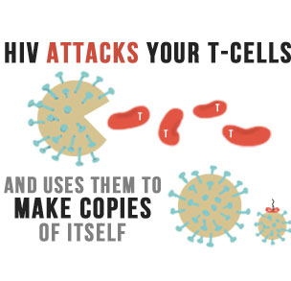
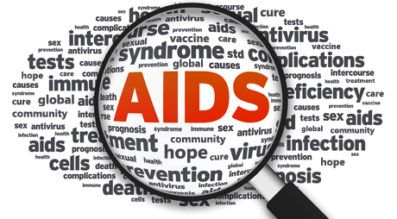
http://aids.gov/
Est. 1981

Slide 27
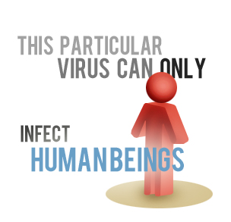
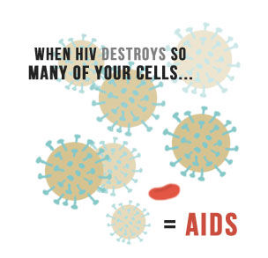
What is HIV/AIDS?
When HIV destroys so many of your cells it becomes AIDS.
  A = Acquired. You acquire AIDS after birth
  I = Immune. Body’s immune system.
  D = Deficiency. When your immune system doesn’t work properly.
  S = Syndrome. Collection of symptoms and signs of disease.

Slide 28
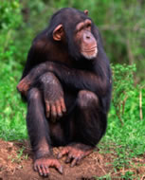
Where did HIV/AIDS come from?
Scientists identified a type of chimpanzee in West Africa as the source of HIV infection in humans. They believe that the chimpanzee version of the immunodeficiency virus (called simian immunodeficiency virus or SIV) most likely was transmitted to humans and mutated into HIV when humans hunted these chimpanzees for meat and came into contact with their infected blood. Over decades, the virus slowly spread across Africa and later into other parts of the world.

Slide 29
How is HIV/AIDS spread?
Unprotected sex
Having multiple sex partners
Sharing needles ( drug addicts)
Being born with an infected mother (birth or breastfeeding)
Blood transfusions/organ transplants
Eating food pre-chewed by an HIV/AIDS infected person
Broken skin/wound
Tattooing or body piercing

Slide 30
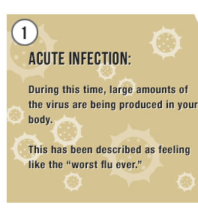
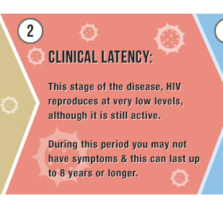
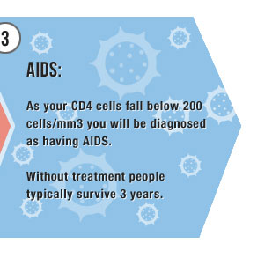
HIV/AIDS Life Cycle

Slide 31
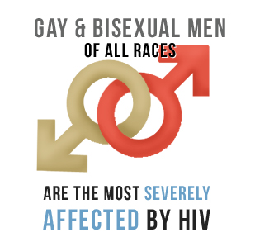
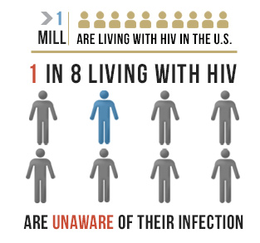
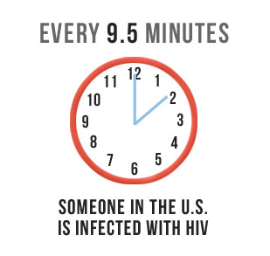
U.S Statistics
1.7 million people are infected with HIV/AIDS

Slide 32
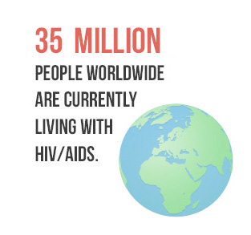
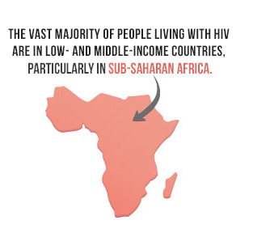
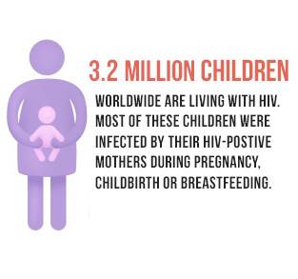
Global Statistics
35 million people currently living with HIV/AIDS
25 million people have died, since discovered in 1981

Slide 33
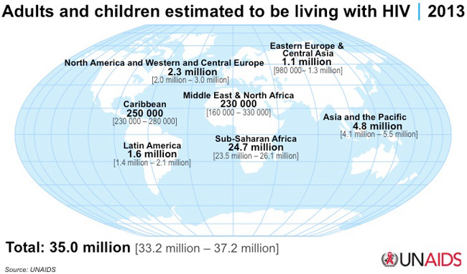

Slide 34
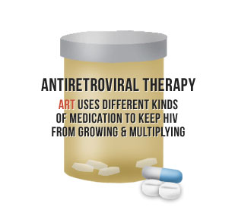
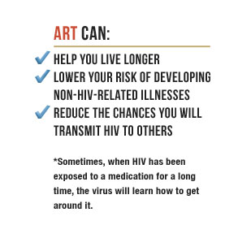
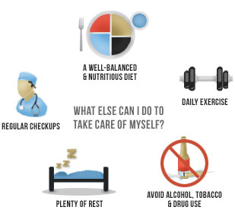
Treatments
Five classes of drugs, which attack HIV at different cycles of life

