Slide 1
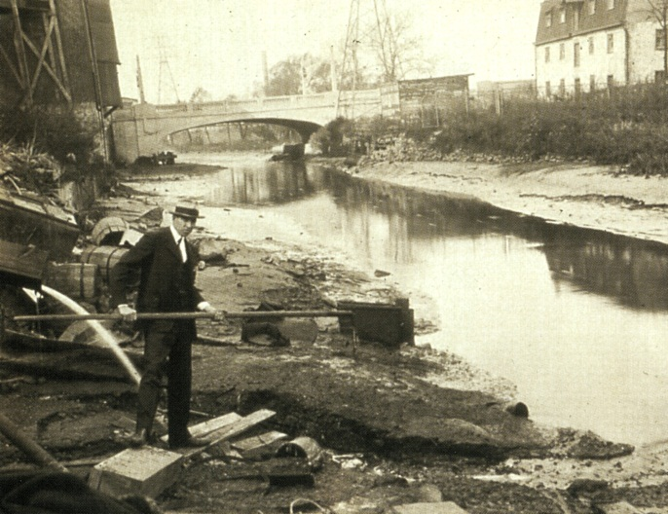
The Environment and Your Health
Chapter 26

Slide 2
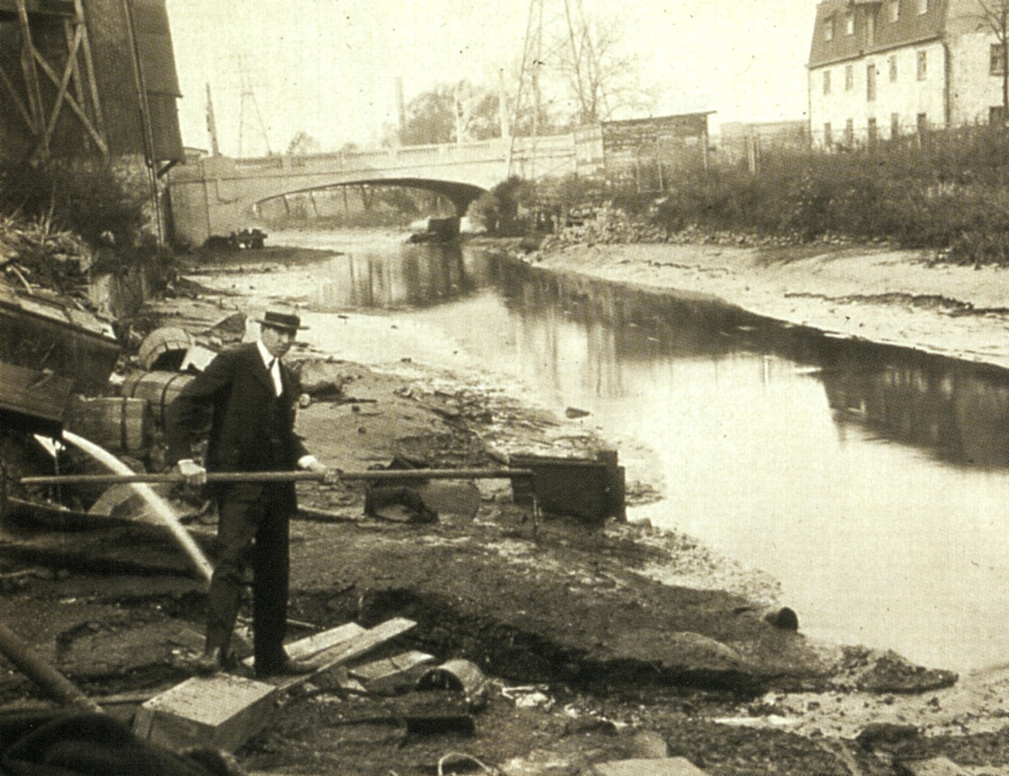
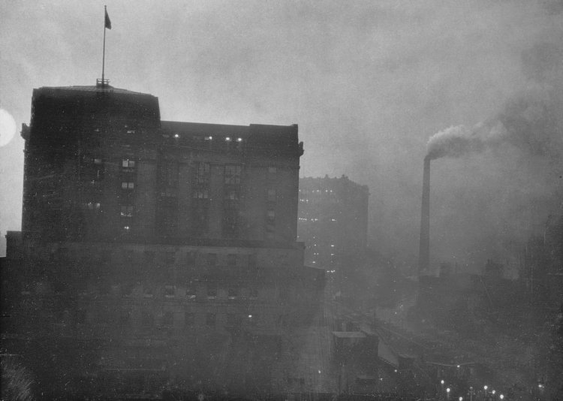
The Impact of Pollution
Pollution: contamination of the environment with anything that impairs its ability to support life.

Slide 3
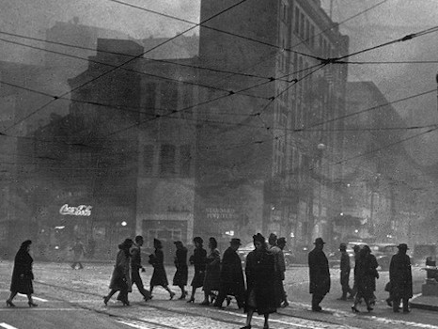
Downtown Pittsburgh

Slide 4
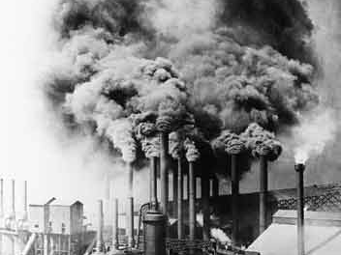
Steel Mills of Pittsburgh

Slide 5
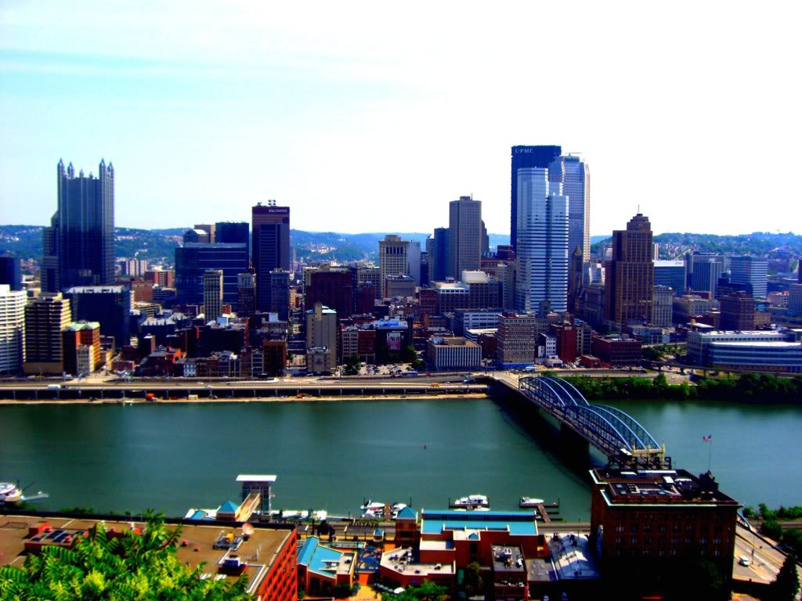
No longer #1!!!
http://www.weather.com/health/airquality/top-10-most-polluted-cities-
20130125?pageno=11
Bakersfield, CA; Hanford, CA; Los Angeles; Visalia, CA;
Fresno, CA; Pittsburgh, PA (#6); Phoenix, AZ; Cincinnati, OH, Louisville, KY; Philadelphia, PA

Slide 6
Rust to Renewal: Pittsburgh’s Green Economy
http://www.youtube.com/watch?v=LBQYKrfRinc

Slide 7
Common Air Pollutants and Their Sources
http://www.youtube.com/watch?v=UtdKRvWC1yQ

Slide 8
Current Global Problems pg. 704-705
Hunger, Poverty, and population.
Losses of land to produce food.
Depletion of ozone (accelerating fossil fuel)
Air pollution
Acid Rain
Global Warming (greenhouse effect)
Water shortages
Forests are shrinking and deserts are increasing.
Ocean and lake pollution (killing fish)
Extinctions of species

Slide 9
How Can We Fix These Problems?
Class Discussion

Slide 10
What Can Government do the Help?
Kyoto Protocol: an agreement signed by many of the world’s leaders in 1997, that spells out the degree of reduction in carbon dioxide emission required of each nation by the year 2012.
Government can also:
  promote going green in schools and businesses.
  give out recycling bins to many places, and give out reusable shopping bags.
  Promote solar and wind energy instead of coal.
  Promote green cars and green appliances.
  Pass bills to do these things!

Slide 11
Energy Riddles
Why did the foolish gardener plant a light bulb?
  He wanted to grow a power plant!
How did Benjamin Franklin feel when he discovered electricity?
  He was shocked!
How is energy conservation like a baseball team?
  They can both use a switch hitter!
What is burned by cars driven late at night?
  Midnight Oil!
What is a renewable energy source that is used every day at your school?
  Brain Power!
How many energy students does it take to change a light bulb?
  None! They are smart enough to use energy efficient compact fluorescent bulbs, which rarely need to be replaced!

Slide 12
Were Green Energy investments worth the gamble?
http://video.foxnews.com/v/1642633456001/were-green-energy-investments-worth-the-gamble/

Slide 13
Products that Benefit the Earth
Compact fluorescent light bulbs.
Cloth or net shopping bags
Cloth dishcloths, napkins, and towels.
Dishes, cups, glasses, and tableware to replace the disposable versions.
Flow-reducing showerheads.
Energy efficient appliances
Good quality bicycle
Recycled paper products.

Slide 14
Food Chain
Pg. 711

Slide 15

Home Energy Use
How many appliances do you use a day?
  (shower, blow dryer, straightener, fridge, sink, 3 lights, microwave, car, toilet, garage door)

Slide 16
Solar Power/Wind Power
Wind Power Car-http://video.foxnews.com/v/1642893401001/wind-powered-car-turns-heads/
The average U.S home produces 13,000lbs of greenhouse gases from electricity a year.
  Active Solar can help generate electricity from sunlight and reduce the greenhouse gases.
  Savings in utilities pay back the initial investment within 7 years.

Slide 17
Consumer and the Health Care System
Chapter 27

Slide 18
Health Care System
Health Care System: the total of all health care providers and medical treatment facilities that work together to provide medical care to the population.
  Do you have a Doctor? Dentist? Eye Doctor?
  Have you had Surgery? Broken bone? Flu?
  Have you been to Med Express?
  Do you take medications? Asthma?

Slide 19
Approaches to Health Care
No Insurance Plan
Insurance Plan
Pay in advance for all treatment.
Comes out of your OWN pocket.
Usually NOT best care.
VERY EXPENSIVE!
Pay monthly fee for insurance ($50)
Do not pay the costs when you seek care.
Routine check-ups.
Opportunity for any care.

Slide 20
Five types of Personal Health Care Insurance.
Hospitalization insurance. Insurance to pay cost of hospital stay.
Surgical insurance. Insurance to pay the surgeon’s fee.
Medical insurance. Insurance to pay physicians’ fees, lab fees, and fees for prescription medications.
Major medical insurance. Insurance to pay high bills not covered by other insurance.
Disability insurance. Insurance to replace lost income if a person should be unable to work due to long illness.

Slide 21
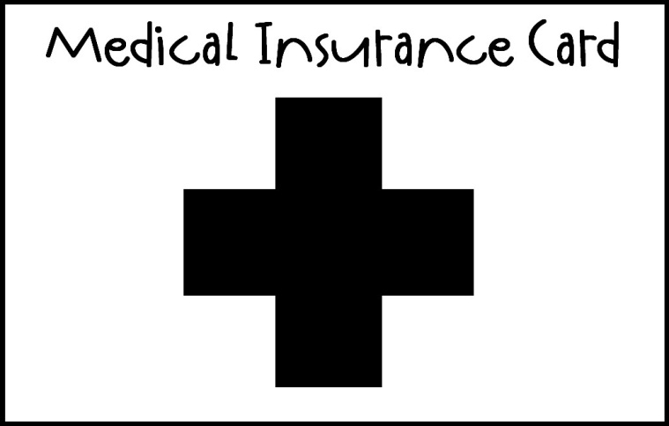
Medicare vs. Medicaid
Medicare: hospitalization insurance for people who are receiving Social Security benefits, pays hospital expenses for senior citizens.
Medicaid: hospitalization and surgical insurance available for people who qualify as needy.

Slide 22

Key Notes about Health Care
Always seek a second opinion before allowing any test or surgery.
90% of hospital bills contain errors. Read through the bill so you are not overcharged.
Use hospital on weekdays; avoid weekends.
Ask about each facility’s policy payment.
Be willing to go out of state if necessary.

Slide 23
Problems and Advantages of Our Health Care System.
Pg. 736

